Slide 1
Digital Portfolio
STUDENT NAME: RAJESWARI K
REGISTER NO AND NMID: D0A5BB68A9C9A13A3E64C42857D06CE9
DEPARTMENT: BCA II YEAR
COLLEGE: COLLEGE/ UNIVERSITY:GOVERNMENT ARTS and SCENE COLLEGE THITTAGUDI/ANNAMALAI UNIVERSITY

Slide 2
PROJECT TITLE
Digital portfolio

Slide 3


AGENDA
Problem Statement
Project Overview
End Users
Tools and Technologies
Portfolio design and Layout
Features and Functionality
Results and Screenshots
Conclusion
Github Link
3/21/2024 Annual Review

Slide 4

PROBLEM STATEMENT
This makes it difficult to showachievements effectively. Our project solves this by creating a clean, user-friendly, and responsive portfolio website.

Slide 5

PROJECT OVERVIEW
Objective: Briefly explain the main goal of your project. Outcome: State what result or benefit the project delivers. Example (if it’s a website project): Objective: To create a user-friendly website for tracking daily expenses.

Slide 6

WHO ARE THE END USERS?
Website for Expense Tracking: End users = People who want to manage their daily expenses. School Management System: End users = Teachers, Students, Parents, and Admin staff. E-commerce App: End users = Customers who shop online.

Slide 7

TOOLS AND TECHNIQUES
Tools: List the software, frameworks, or platforms used. > Example: Python, MySQL, VS Code, Canva Techniques: Mention the approach or methodology. > Example: Agile Methodology, Waterfall Model, Data

Slide 8
POTFOLIO DESIGN AND LAYOUT
Desing: Clean, minimal, and professional look Consistent color scheme and typography Focus on readability and easy navigation
Layout: Home Page: Brief intro + photo/banner About Page: Skills, experience, and bio Projects Section: Showcase of work with images and linkes
8

Slide 9
FEATURES AND FUNCTIONALITY
Features:
• Responsive design (works on mobile & desktop)
• Clean and professional UI
• Organized sections –
Home, About, Projects, Contact
Functionality:
• Easy navigation between sections

Slide 10
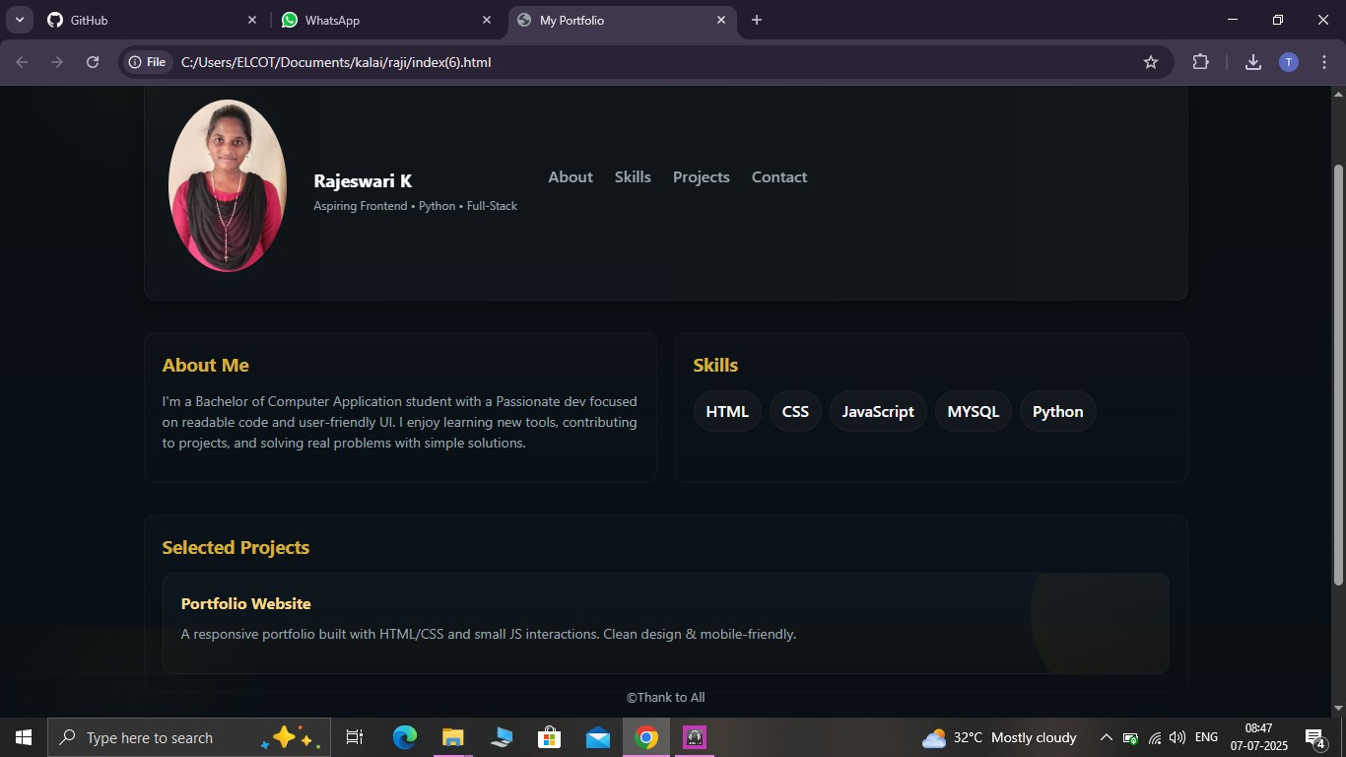

RESULTS AND SCREENSHOTS
3/21/2024 Annual Review
10

Slide 11
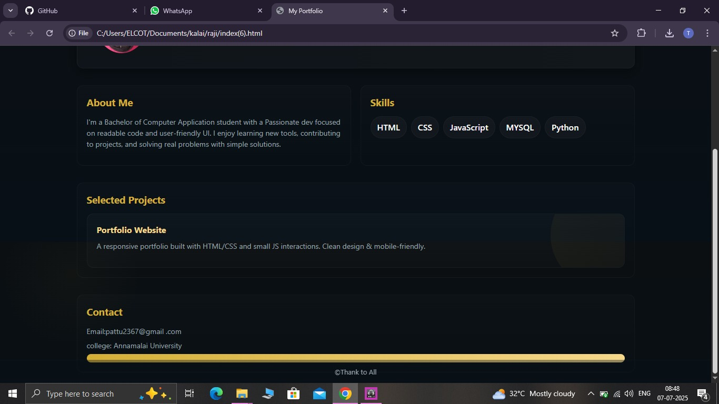
RESULTS AND SCREENSHOTS

Slide 12
CONCLUSION
This digital portfolio showcases my skills, projects, and achievements in a professional way.
12

Slide 13
GitHub link
https://github.com/RAJESWARIK2006/RajeswariK-TNSDC-FWD-DP.git

